Slide 1
CPU Scheduling
Dr. Manmath N. Sahoo
Dept. of CSE, NIT Rourkela

Slide 2
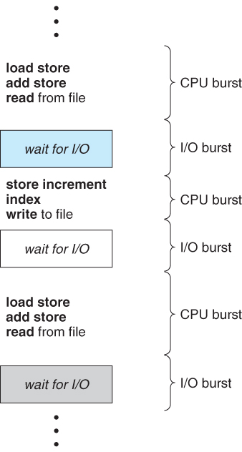
CPU-I/O Burst Cycle
CPU–I/O Burst Cycle – Process execution consists of a cycle of CPU execution and I/O wait.
CPU burst is length of time process needs to use CPU before it next makes a I/O request.
I/O burst is the length of time process spends waiting for I/O to complete.

Slide 3
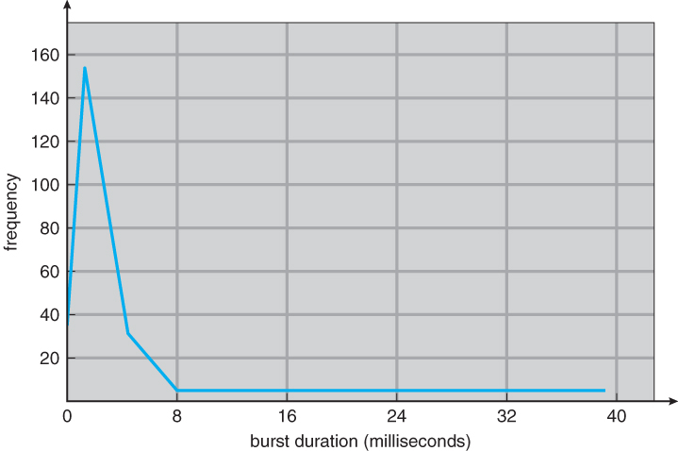
Histogram of CPU-burst Times
Typical CPU burst distribution

Slide 4
CPU Scheduler
Allocates CPU to one of processes that are ready to execute (in ready queue)
CPU scheduling decisions may take place when a process:
Switches from running to waiting state (e.g. I/O request)
Terminates
Switches from waiting to ready (e.g. I/O completion)
Switches from running to ready state (e.g. priority based interruption)
Scheduling only when 1 and 2 happen is nonpreemptive - process keeps CPU until it voluntarily releases it
Scheduling also when 3 & 4 happen is preemptive - CPU can be taken away from process by OS

Slide 5
Dispatcher
Dispatcher gives control of the CPU to the process selected by the short-term scheduler; this involves:
switching context
switching to user mode (if CPU was executing the previous process in kernel mode and preempted)
jumping to the proper location in the user program to restart that program (i.e., last action is to set program counter)
Dispatch latency – time it takes for the dispatcher to switch between processes and start new one running

Slide 6
Scheduling Criteria
CPU utilization: i.e. CPU usage – want to maximize
Throughput: number of processes that complete their execution per time unit – want to maximize
Turnaround time: amount of time to execute a particular process – want to minimize
Waiting time: amount of time a process has been waiting in the ready queue – want to minimize
Response time: amount of time it takes from when a job was submitted until it initiates its first response (output) – want to minimize

Slide 7
First-Come, First-Served Scheduling
Schedule: order of arrival of process in ready queue
Example: Process Burst Time
P₁ 24
P₂ 3
P₃ 3
Suppose that the processes arrive in the order: P₁ , P₂ , P₃. The Gantt Chart for the schedule is:
Waiting time for P₁ = 0; P₂ = 24; P₃ = 27
Average waiting time: (0 + 24 + 27)/3 = 17
P₁
P₂
P₃
0
24
27
30

Slide 8
FCFS Scheduling
Suppose that the processes arrive in the order P₂ , P₃ , P₁ .
The Gantt chart for the schedule is:
Waiting time for P₁ = 6; P₂ = 0; P₃ = 3
Average waiting time: (6 + 0 + 3)/3 = 3
P₂
P₃
P₁
0
3
6
30

Slide 9
FCFS Scheduling
Simple to implement by FIFO queue.
Code is easy to write and understand
Average waiting time is not minimal
Not suitable for time-sharing systems
Convoy effect: short I/O intensive processes behind long CPU intensive process
NOTE: FCFS Scheduling is non-preemptive

Slide 10
Shortest-Job-First (SJF) Scheduling
Schedule: order of the CPU burst of the processes.
Two schemes:
Non-Preemptive SJF / Shortest Job Next (SJN)
once CPU given to the process it cannot be preempted until completes its CPU burst.
Preemptive SJF / Shortest Remaining Time First (SRTF)
if a new process arrives with CPU burst length less than remaining time of current executing process, preempt.

Slide 11
Non-Preemptive SJF (SJN)
Process Arrival Time Burst Time
P₁ 0 7
P₂ 2 4
P₃ 4 1
P₄ 5 4
Gantt Chart:
Average waiting time = (0 + 6 + 3 + 7)/4 = 4
P₁
P₃
P₂
P₄
0
3
7
8
12
16

Slide 12
Preemptive SJF (SRTF)
Process Arrival Time Burst Time
P₁ 0 7
P₂ 2 4
P₃ 4 1
P₄ 5 4
Gantt Chart:
Average waiting time = (9 + 1 + 0 +2)/4 = 3
P₁
P₂
P₃
P₂
P₄
P₁
0
2
4
5
7
11
16

Slide 13
Example
Process Arrival Time Burst Time
P1 0 16
P2 2 8
P3 4 12
P4 6 2
P5 8 4
Draw Gantt chat and find the average waiting time in each of the following cases:
SRTF Scheduling
SJN Scheduling
FCFS Scheduling

Slide 14
Answer to Example
Process Arrival Time Burst Time
P1 0 16
P2 2 8
P3 4 12
P4 6 2
P5 8 4
SRTF
Average waiting time = (26+6+12+0+0)/5
= 8.8
P1 | P2 | P2 | P4 | P2 | P5 | P3 | P1
0 | 2 | 4 | 6 | 8 | 12 | 16 | 28 | 42

Slide 15
Answer to Example
Process Arrival Time Burst Time
P1 0 16
P2 2 8
P3 4 12
P4 6 2
P5 8 4
SJN
Average waiting time = (0+20+26+10+10)/5
= 13.2
P1 | P4 | P5 | P2 | P3
0 | 16 | 18 | 22 | 30 | 42

Slide 16
Answer to Example
Process Arrival Time Burst Time
P1 0 16
P2 2 8
P3 4 12
P4 6 2
P5 8 4
FCFS
Average waiting time = (0+14+20+30+30)/5
= 18.8
P1 | P2 | P3 | P4 | P5
0 | 16 | 24 | 36 | 38 | 42

Slide 17
Answer to Example
Scheduling Algorithm | Average Waiting Time
FCFS | 18.8
SJN | 13.2
SRTF | 8.8

Slide 18
Shortest Job First
SRTF is Optimal: Minimum Average waiting time.
Longer processes may be starved.
Difficult to know the CPU burst of processes before their execution

Slide 19
Determining Length of Next CPU Burst
Can only estimate the length.
Can be done by using the length of previous CPU bursts, using exponential averaging (decaying average).

Slide 20
Determining Length of Next CPU Burst

Slide 21
Determining Length of Next CPU Burst
If we expand the formula, we get:
τ_{n+1} = α t_{n}+(1 - α) α t_{n-1} + …
+(1 - α )^{j} α t_{n-j} + …
+(1 - α )^{n+1} τ₀
Since both α and (1 - α) are less than or equal to 1, each successive term has less weight than its predecessor.

Slide 22
Round Robin (RR) Scheduling
Each process gets a time quantum, usually 10-100 milliseconds.
After this time has elapsed, the process is preempted and added to the end of the ready queue.
If there are n processes in the ready queue and the time quantum is q, then each process gets 1/n of the CPU time.
No process waits more than (n-1)q time units.

Slide 23
Example: RR with q= 20
Process Burst Time
P₁ 53
P₂ 17
P₃ 68
P₄ 24
The Gantt chart is:
Typically, higher average turnaround than SJF, but better response.
P₁
P₂
P₃
P₄
P₁
P₃
P₄
P₁
P₃
P₃
0
20
37
57
77
97
117
121
134
154
162

Slide 24
Round Robin (RR) Scheduling
FCFS + Preemption = RR
Performance
q large ⇒ behaves similar to FCFS
q small ⇒ more context switch overhead

Slide 25
Modified RR Scheduling
Based on variable time quantum
A preempted process, on its next turn will use an increased time quantum
RR Scheduling
P₁: 300ms, q=20ms, time per context switch=2ms
#of preemptions due to this process = 14
Preemption overhead = 28ms

Slide 26
Modified RR Scheduling
Modified RR Scheduling – q is doubled in next turn.
P₁: 300ms, q=20ms (initial)
#of preemptions due to this process = 3. (20+40+80+160=300)
Preemption overhead = 6ms

Slide 27
Priority Scheduling
A priority number (integer) is associated with each process and the CPU is allocated to the process with the highest priority
Some schemes use smallest integer ≡ highest priority.
SJF is effectively priority scheduling where priority is defined on next CPU burst time.
FCFS is effectively priority scheduling where priority is defined on arrival time.

Slide 28
Priority Scheduling
Problem: Starvation – low priority processes may never execute.
Solution: Aging – as time progresses increase the priority of the process.
e.g. in every 10ms increase the priority of process by 1

Slide 29
Multi level Queue Scheduling
Ready queue is partitioned into separate queues.
Each queue holds a particular category of processes.
Each queue can implement whatever scheduling algorithm is most appropriate for that type of processes.

Slide 30
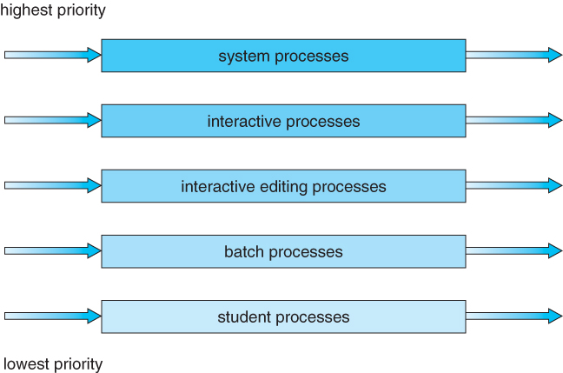
Multi level Queue Scheduling

Slide 31
Multilevel Queue Scheduling
Scheduling must be done between the queues.
Priority scheduling; But possibility of starvation.
Time slice – each queue gets a certain amount of CPU time which it can schedule amongst its processes;

Slide 32
Multilevel Feedback Queue Scheduling
A process can move between the various queues; aging can be implemented this way.
Multilevel-feedback-queue scheduler defined by the following parameters:
number of queues
scheduling algorithms for each queue
method used to determine when to promote a process
method used to determine when to demote a process
method used to determine which queue a process will enter initially

Slide 33
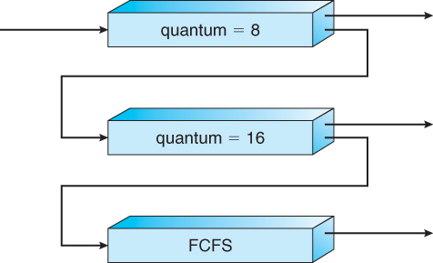
Multilevel Feedback Queue Scheduling

Slide 34
Highest Response Ratio Next (HRRN) Scheduling
It gives priority to shorter jobs similar to SJN
Implements Aging implicitly
Non-preemptive dynamic priority based algorithm with initial priority 1
p=1+(wait time/burst time)

Slide 35
Highest Response Ratio Next (HRRN) Scheduling
Process Arrival Time Burst Time
P1 0 3
P2 2 6
P3 4 4
P4 6 5
P5 8 2
P1 | P2 | P3 | P5 | P4
0 | 3 | 9 | 13 | 15 | 20

Slide 36
Multi Processor Scheduling
Separate queue for each processor
Common ready queue

Slide 37
Multi Processor Scheduling: Separate queues
4 Processors: C1, C2, C3, C4.
P1 goes to C1
P2 goes to C2
P3 goes to C3
P4 goes to C4
P5 goes to C1
P6 goes to C2 …
Load balancing w.r.t size of the processes???
C1 may be overloaded, while C3 is idle

Slide 38
Multi Processor Scheduling: Common ready queue
Symmetric Approach:
Each processor examines the common ready queue and selects a process to execute.
Several instances of STS will be running on different processors, whenever necessary
Mutual exclusive access to the common queue???
Asymmetric Approach
One processor acts as scheduler (Master) for other processor (Slaves)

